Slide 1
Hands-On Machine Learning in Simulation and Reality with the da Vinci Research Kit
ISMR 2023

Slide 2
Agenda
Installation of assets (AMBF+Surgical robotics challenge+dVRK segmentation)
Replay rosbag on AMBF
Data collection
Label generation
Training of neural networks
Real-time inference

Slide 3
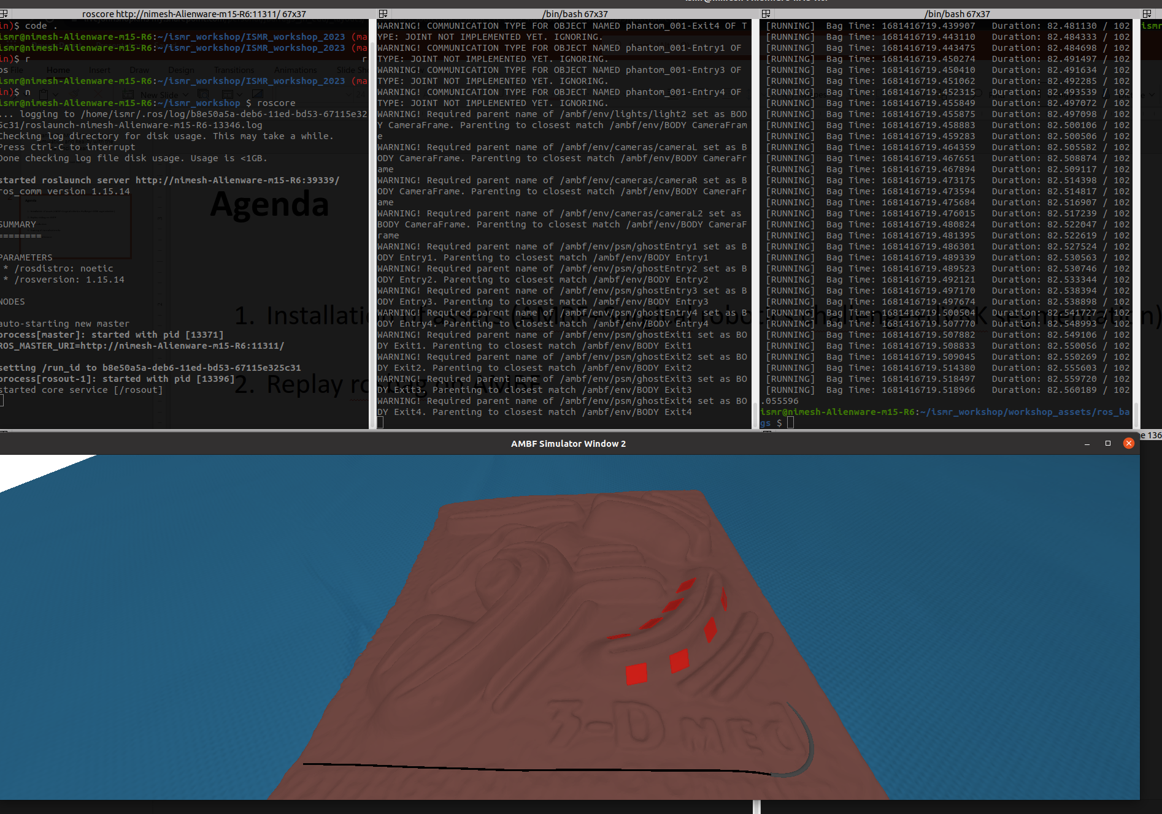
Step 2: Replay rosbag on AMBF

Slide 4
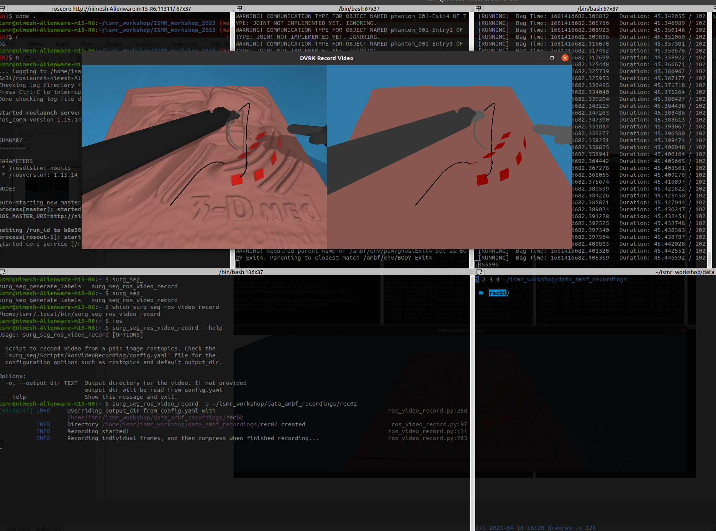
Step 3: Data collection

Slide 5
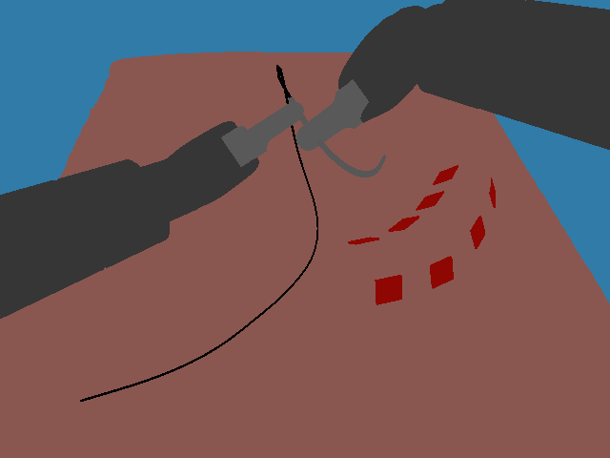
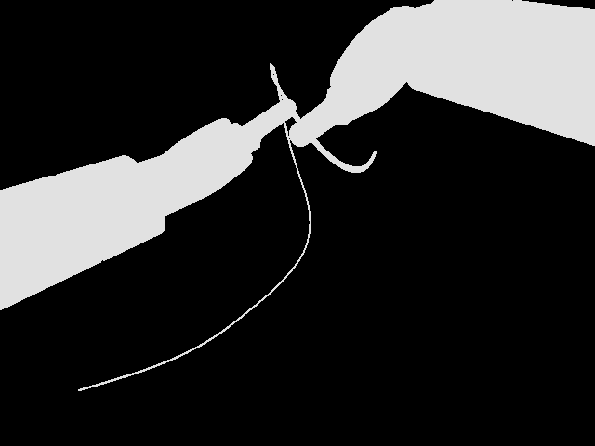
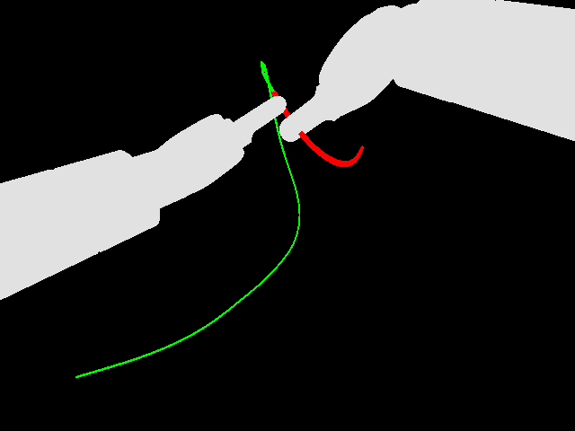
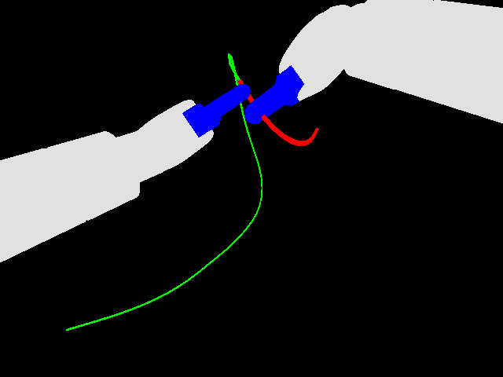
Step 3: Label generation
output of AMBF
2colors
2colors
5colors

Slide 6
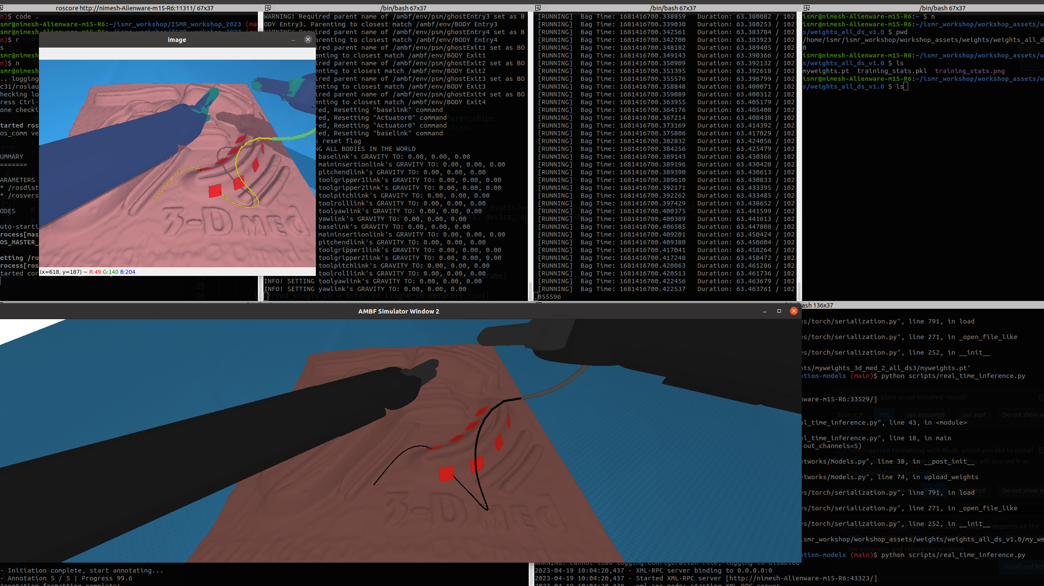
Step 5: Real-time inference

